Slide 1
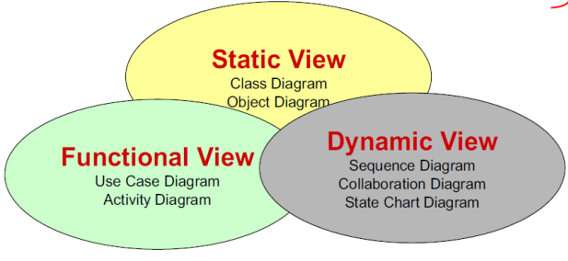
Software Engineering: The goal is to produce high quality software to satisfy a set of functional and nonfunctional requirements
Problem solving activity: that deals with complexity and change while developing quality software with limited time and budget:
Complexity (multiple programmers, one bug causes another) is dealt with by using 1. Abstraction 2. Decomposition 3. Hierarchy
1. Abstraction can be handled through Modeling
Modeling ignores unessential details focusing on the questions the model is intended to answer. There are 3 models 1. System, 2. Task, 3. Issue:
1. System Models
1. Functional Model:
UML Notation of: 1. Use Case Diagrams
Functional Behavior of the system as seen by the user
2. Object (Structural) Model:
UML Notation of: 1. Class Diagrams
Static Structure of the system; Objects, Attributes, Associations
3. Dynamic Model:
UML Notation of: 1. Interaction (Sequence) Diagrams
Dynamic Behavior between actors and the system and between objects and the system
2. Statechart Diagrams
Dynamic Behavior of an individual object
3. Activity Diagrams
Dynamic Behavior of a system
2. Task Model; dependencies, time limits, roles
3. Issues Model; open/closed, constraints
2. Decomposition through “divide and conquer” 2 types of decomposition 1. Functional 2. Object-Oriented
1. Functional Decomposition “modules” each module is a major processing step – Functionality is spread over the entire system. Single change can effect the entire system-hard to understand/maintain/create a UI
2. Object-oriented Decomposition “objects” each class is a major
abstraction
3. Hierarchy – through “Layering” chunks (classes and objects) through
“consists of” and “kind-of” Inheritance helps to organize concepts into
hierarchies
Change (Entropy increases, costs increase as time goes on). 3 ways to deal with change
1. Tailor or use a nonlinear software lifecycle to deal with changing requirements
and project conditions
2. CM
Application Domain
(Requirements Analysis)
Solution Domain
(System Design, Object Design)

Slide 2
System, Model, View, Actor, Instances
System: Organized set of communicating parts for a specific purpose
Model: Abstraction describing a subset of the system
View: depicts selected aspects of the system
Notation: set of graphical or textual rules for depicting views
Actor: Entity outside the system to be modeled, interacting with the system
Class: Abstraction modeling an entity in the
Object: Instant of a class
Model 2: Flight Simulator
View 2:
View 1: Blueprints
View 3:
System: Airplane
Model 1: Scale Model
8/29 8

Slide 3
Use Case Diagrams: Functional Behavior of the system as seen by the user. Functional Behavior is represented by the use cases. Together use cases and actors define the boundaries of the system. Used during requirements gathering
Use Case Model is DIFFERENT than Use Case Diagrams:
The use case model is the set of all use cases. It is a complete description of the functionality of the system and it’s environment.
Pacakages: Are Usually not an application domain concept ;)
Generalization (inheritance) is different than <<includes>>. Two use cases that share a common part are generalizations.
Package: Watch System – mechanism to organize elements into groups
Actor Can Be:
User
External System
Physical Environment
Actor:
WatchUser
Actor: WatchRepairPerson
Use cases – class of functionality as an event flow
1. Unique Name
2. Participating Actors
3. Entry Conditions
4. Flow of events
5. Exit Conditions
6. Special requirements
<<includes>> common functionality needed in more than one use case (reuse)
Actor: Model that represents the roles, that is, a type of user (or another system of the system
1. Unique name
2. External i.e. outside the system
3. Communicates, exchanges information or interacts with the system
Use case “flow of events”
<<extends>> exceptional or seldom invoked use case
Use case name should be a verb
Scenario –vs- Use case
1) Name: Purchase Ticket 4) Event Flow:
1. Passenger selects the number of
2) Participating Actors: Zones to be traveled
Passenger 2. Distributor displays the amount due
3. Passenger inserts money, of at
3) Entry Conditions: least the amount due
Passenger standing in front 4. Distributor returns change
of the ticket distributor 5. Distributor issues ticket
Passenger has sufficient
Money for his ticket 5) Exit Conditions: Passenger has ticket
6) Special Requirements: None
A scenario is an actual sequence of interactions (i.e., an instance) describing one specific situation;
A use case is a general sequence of interactions (i.e., a class) describing all possible scenarios associated with a situation.
Scenarios are used as examples and for clarifying details with the client.
Use cases are used as complete descriptions to specify
a user task or a set of related system features.
Use case actors should be a Noun

Slide 4
Class Diagrams: Static Structure of the system; Objects, Attributes, Associations. Can be used for 3 things:
1. during requirements analysis to model problem domain concepts
2. during system design to model subsystems and interfaces
3. during object design to model classes
Becomes and object when noted like dougsAccount: Account note the underline small and capital letters
Associations denote relationships between classes
Class names start with a capital and are singular. Abstract classes are italic
“consists of” or “has an”– Aggregation
A solid diamond denotes composition a strong form of aggregation where components cannot exist without the aggregate
“is kind of” or “is a” Inheritance
Classes – represents a concept
1. Unique Name
2. State (attributes)
a. each attribute has a type
3. Behavior (operations)
b. each behavior has a signature

Slide 5
Interaction (sequence) Diagrams: Dynamic Behavior between actors and the system and between objects and the system . Can be used for 2 things:
1. during requirements analysis to refine use case descriptions and additional “participating” objects
2. during system design to refine subsystem interfaces
Classes (Objects) are represented by columns
First Object is always the Boundary Object – which represents the interaction between the user and the system
Iterations
Activations
Data flow –vs- messages
Create an object then destroy the object
X
Lifelines

Slide 6
StateChart Diagrams: Dynamic Behavior representing a subsystem or a single object. Used during:
1.system design to identify object attributes and to refine the behavior description of an object
Initial state
Transition
States
Final state

Slide 7
Activity Diagrams: Dynamic Behavior of the system. Used during:
1.system design to refine subsystem interfaces
Decision
Swim Lanes – denotes object or subsystem that implements the actions
Dispatcher
FieldOfficer
Splitting then Synchronization of multiple events

Slide 8


objects:Class or Instant names always start with a small letter and are underlined. Objects can be found through proper nouns
Class Diagrams have concept of aggregation, inheritance and multiplicity but Object models do not because that are “exact” instances
* means iterations for Interaction (sequence) Diagrams
Data flow –vs- messages in Sequence Diagrams
System
Boundary
Control
Entity
Chapter 3: Project Organization and Communivation:
Role: Set of responsibilities that can be shared by more than one participant is some cases
Participant: Individual and can have many roles
Client: Contracts the development of the system defining scope and finances
End User: Person who actually uses the system
Work Package: Description of work
Work Product: Actual result of the work

Slide 9
Chapter 4: Requirements Elicitation:
Software Lifecycle: Set of activities and their relationship to each other to support the development of a software system
First Steps: Ask yourself the
1. purpose of the system
2. system boundary
Requirements process:
1. Requirements Elicitation – Definition of the system in terms understood by the customer
2. Requirements Analysis – Technical Specification of the system as understood by the developer
Types of Requirements:
1. Functional
2. Non-functional
3. Constraints “Pseudo requirements”
Scenario –vs- Use case
Application Domain – Customer Language
A scenario is an actual sequence of interactions (i.e., an instance) describing one specific situation;
Scenario Name:
Participating Actors:
Flow of Events:
Scenarios are used as examples and for clarifying details with the client.
A use case is a general sequence of interactions (i.e., a class) describing all possible scenarios associated with a situation.
Unique Name
Participating Actors
Entry Conditions
Flow of events
Exit Conditions
Special requirements
Use cases are used as complete descriptions to specify
a user task or a set of related system features.
Scenarios gives you ->
Use Cases gives you->
Use Case Model gives you->
Relationships between the use cases
Solutions Domain – Developer Language

Slide 10
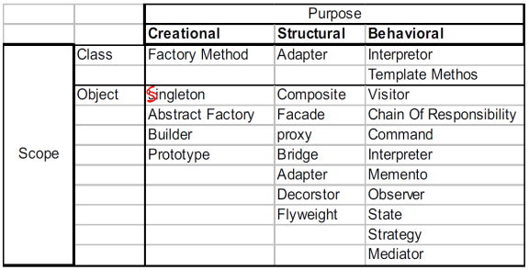
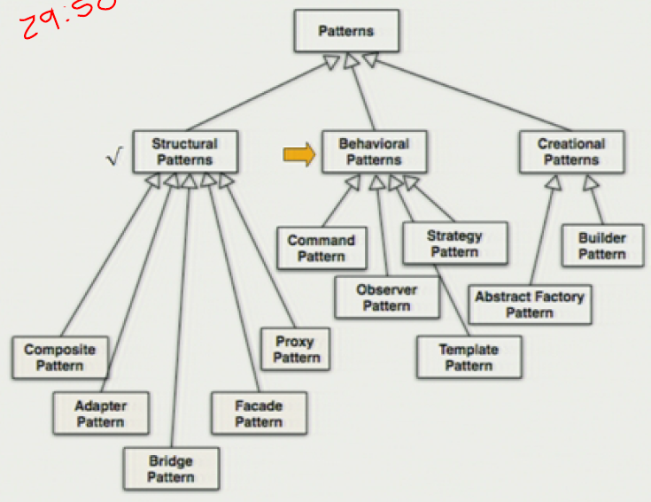
Composite Pattern: Model dynamic aggregates
Models Trees e.g. File Systems
Client
Adapter Pattern: Interfacing to existing systems (legacy systems)
(object adapter – single inheritance)
Client
Bridge Pattern: Interfacing to existing and future systems e.g. multiple data stores
Dynamic delegations
Client
Component
ClientInterface
LegacyClass
Abstraction
Impl
Implementor
Request()
ExistingRequest()
Operation()
Impl-> OperationImpl()
OperationImpl()
adaptee
delegations
Leaf
Composite
Inheritance
Adapter
Children
Request()
Redefined Abstraction 1
Redefined Abstraction 2
Concrete Implementor 1
Concrete Implementor 2
Inheritance followed by delegation
Operation()
Operation()
OperationImpl()
OperationImpl()
Observer Pattern: Decouples an Abstraction from its Views e.g. shoes consistent data in multiple views
delegation followed by Inheritance
Subject
Observer
Invoker
Command
observers
execute()
subscribe()
unsubscribe()
notify()
update()
Client
Command Pattern: Builds a user interface
Receiver
<<binds>>
ConcreteCommand1
Concrete Command2
ConcreteSubject
ConcreteObserver
action1()
action2()
<<binds>>
execute()
execute()
state
observeState
getState()
setState()
update()
Policy
Template Method Pattern: Different algorithms exist for a specific task
Context
Strategy
contextInterface()
observers
AlgorithmicInterface()
AbstractClass
Strategy Pattern: Different algorithms exist for a specific task eg sensor networks
templateMethod()
step1()
step2()
step3()
Builder Pattern: Construction of a complex object is common across several representations e.g. convert documents into different formats
ConcreteStrategyA
ConcreteStrategyB
ConcreteStrategyC
step1();
step2();
step3();
Director
Builder
AlgorithmicInterface()
AlgorithmicInterface()
AlgorithmicInterface()
construct()
buildPart()
ConcreteClass
For all objects in Structure {Builder->BuildPart()}
templateMethod()
step1()
step2()
step3()
ConcreteBuilderA
ConcreteBuilderA
BuildPart()
GetResults()
Abstract Factory Pattern:
BuildPart()
GetResults()
Client
AbstractFactory
AbstractProductA
CreateProductA
CreateProductB
ConcreteFactory1
ProductA1
ProductA2
CreateProductA
CreateProductB
AbstractProductB
ProductB1
ProductB2
ConcreteFactory2
CreateProductA
CreateProductB

Slide 12
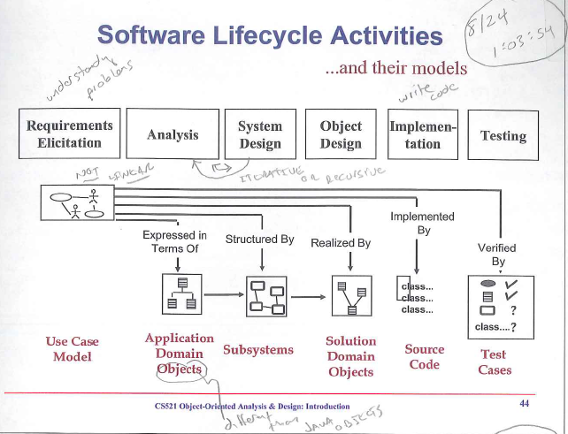
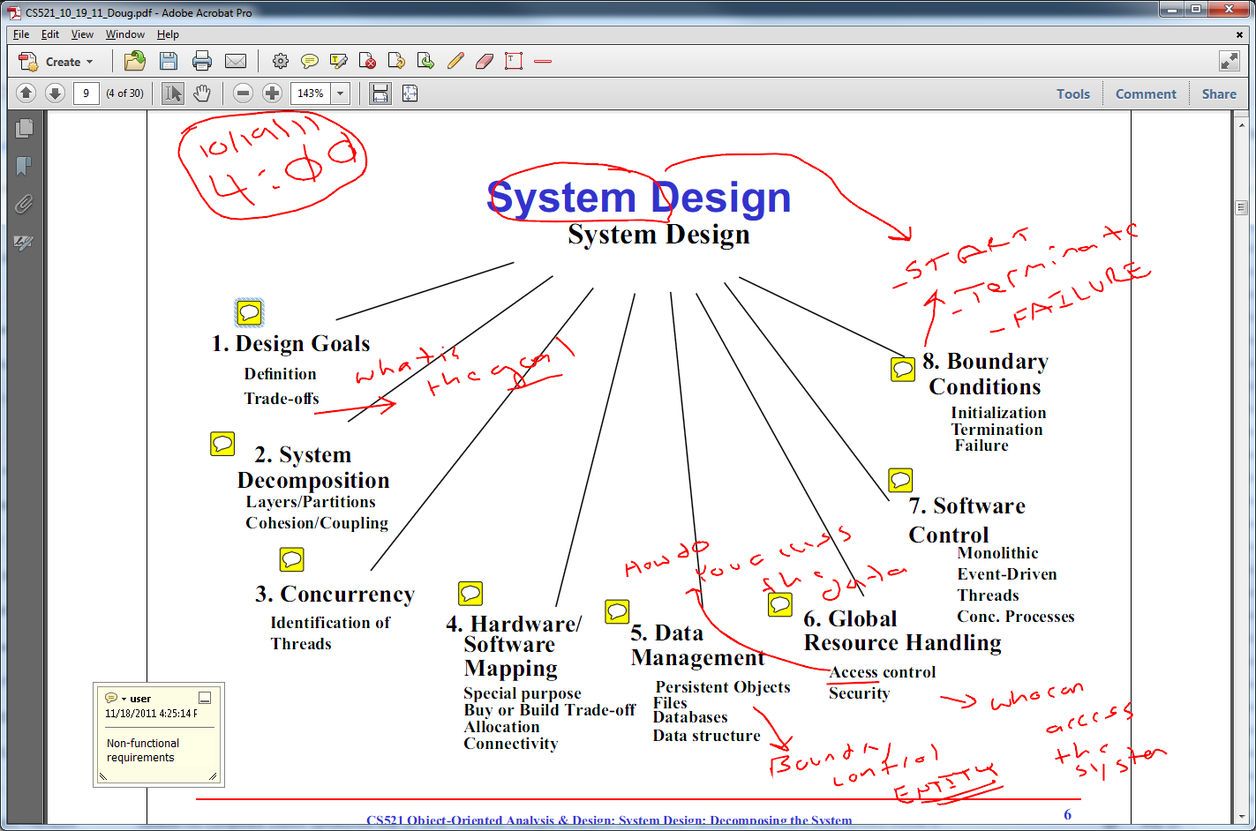
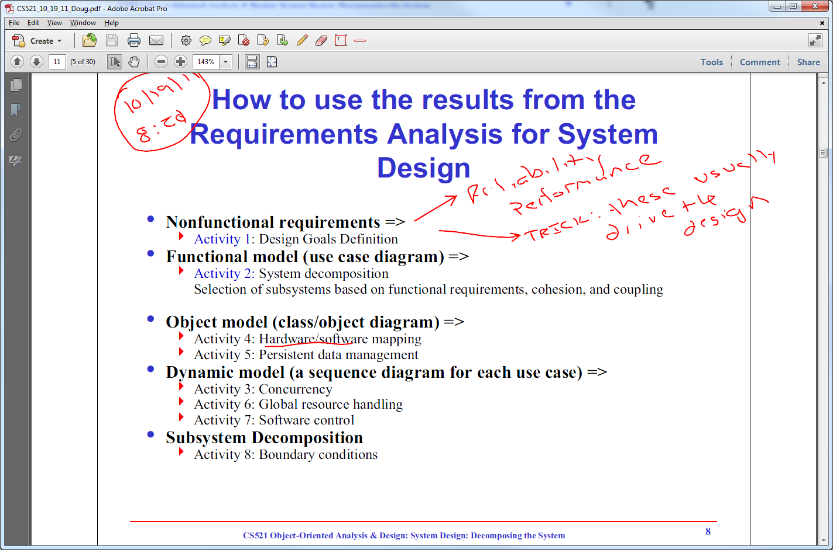
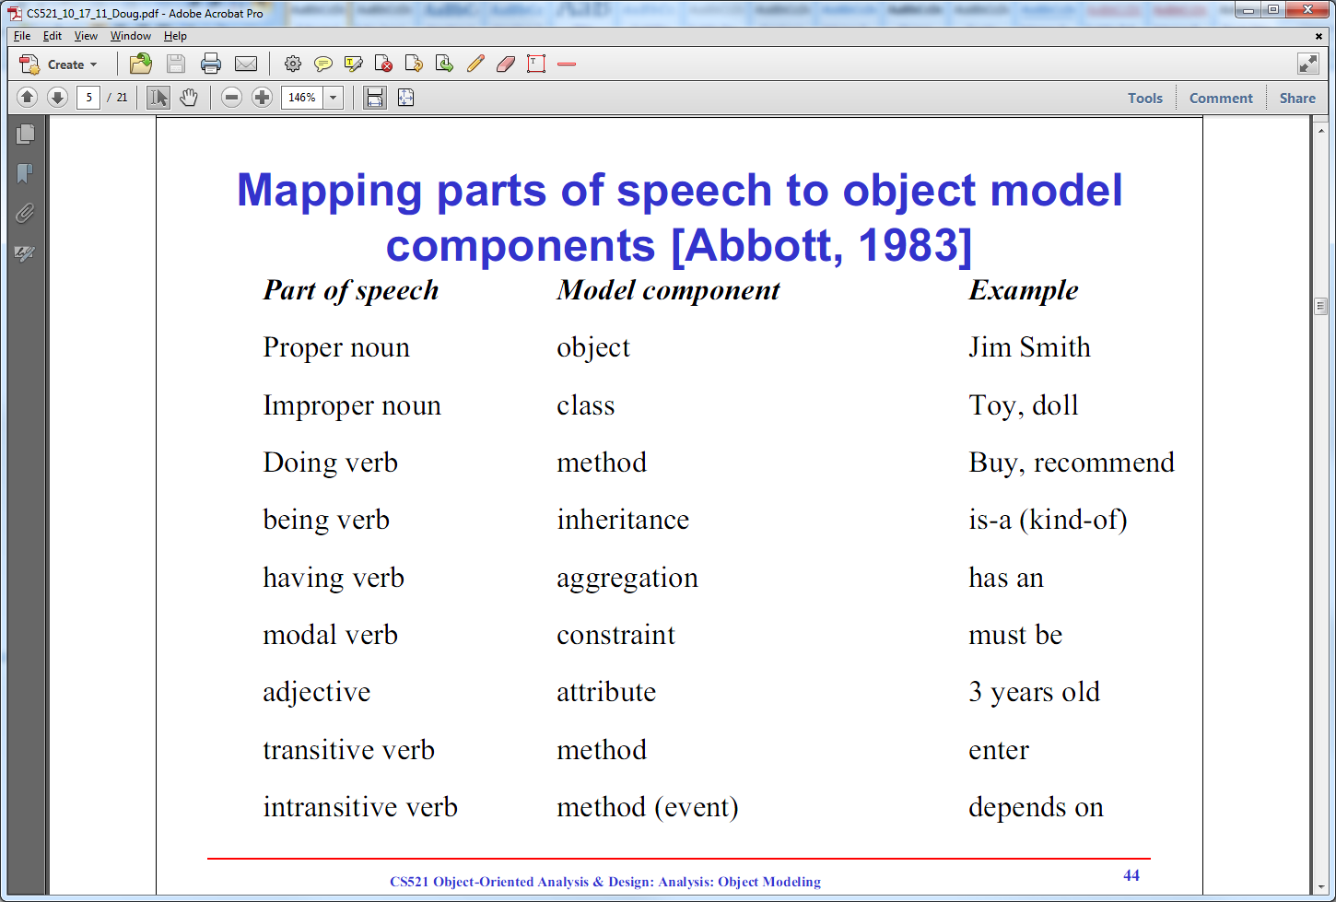

Slide 13
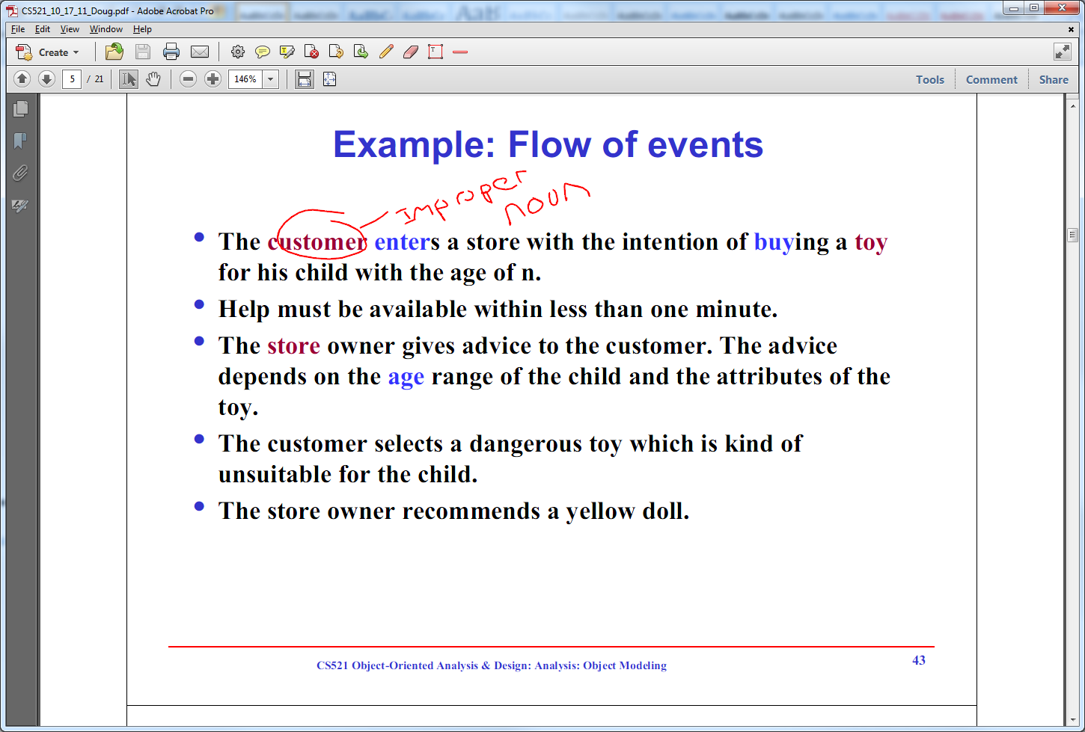
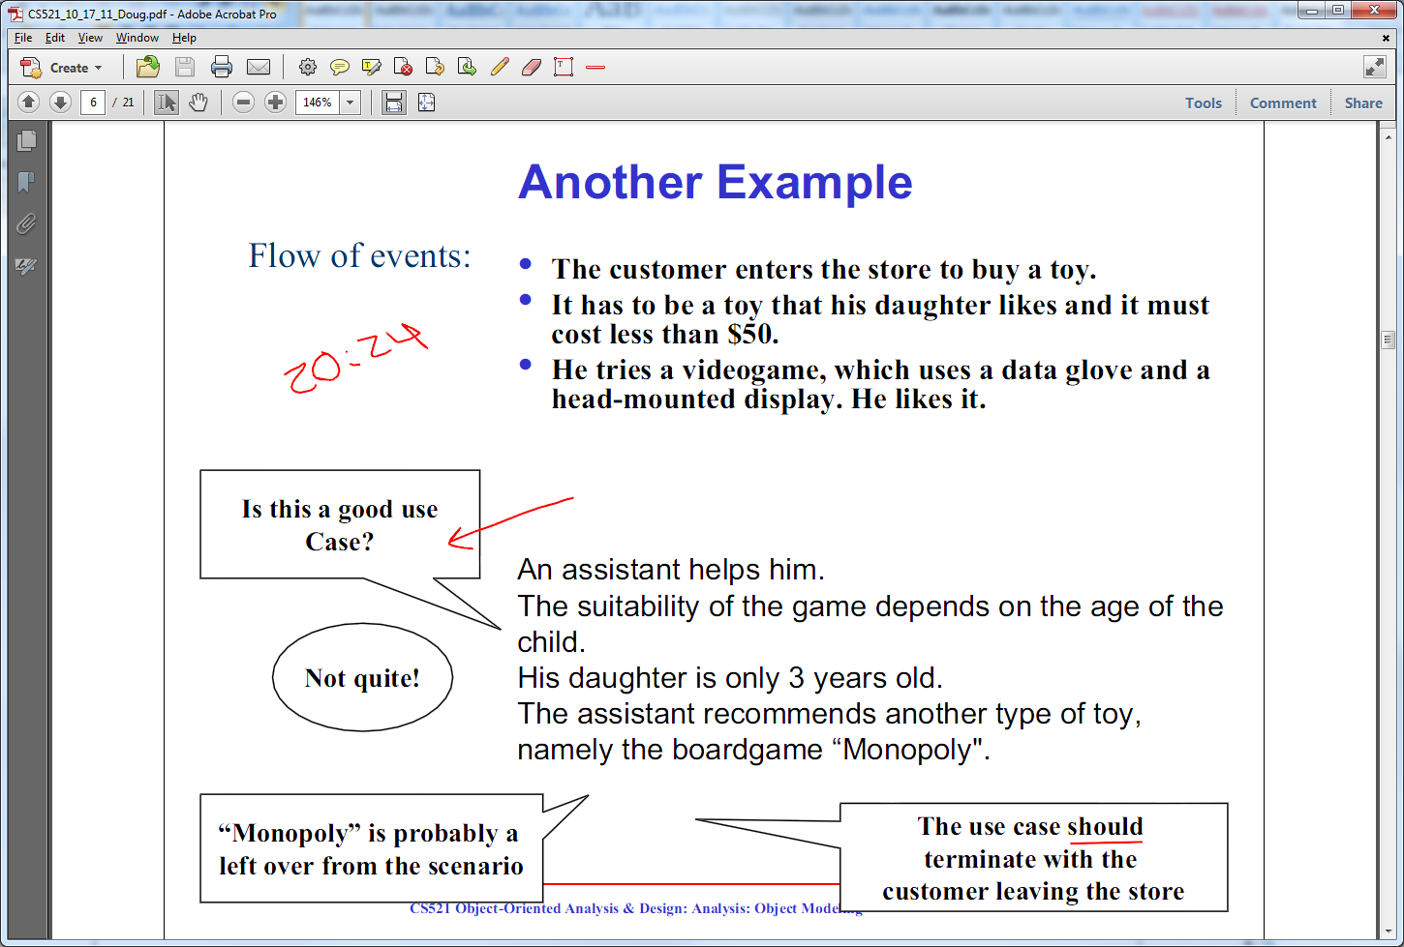
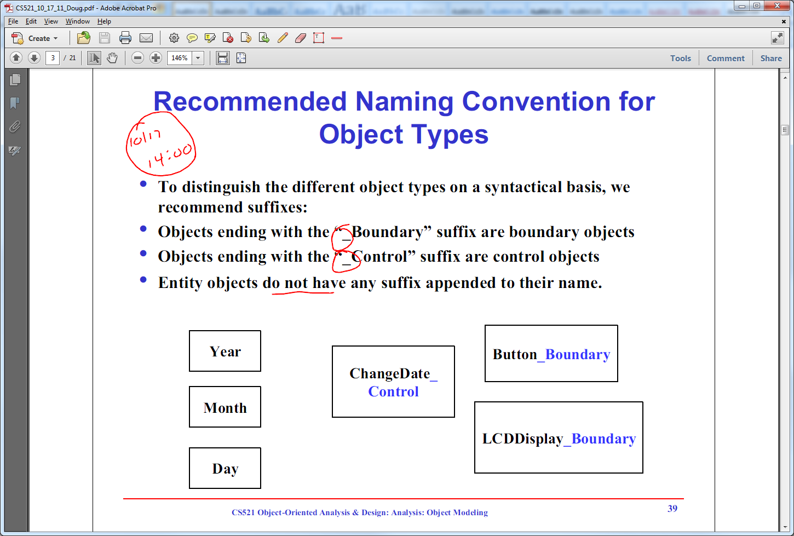
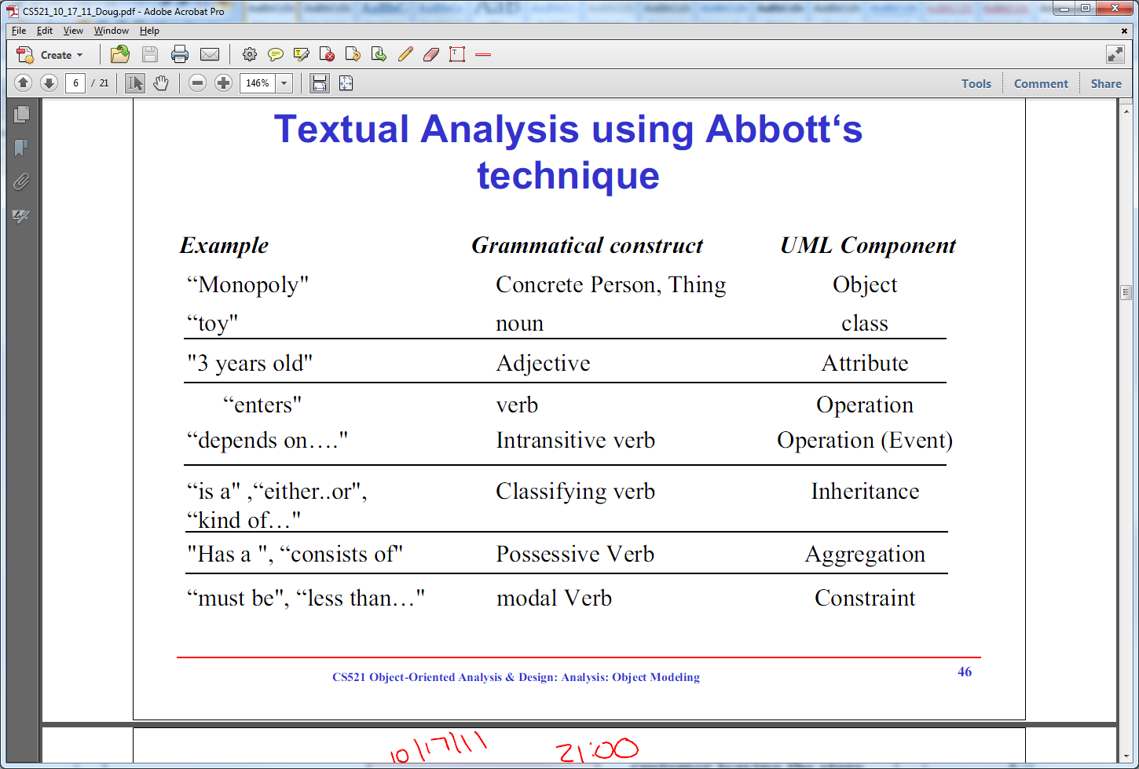

Slide 14
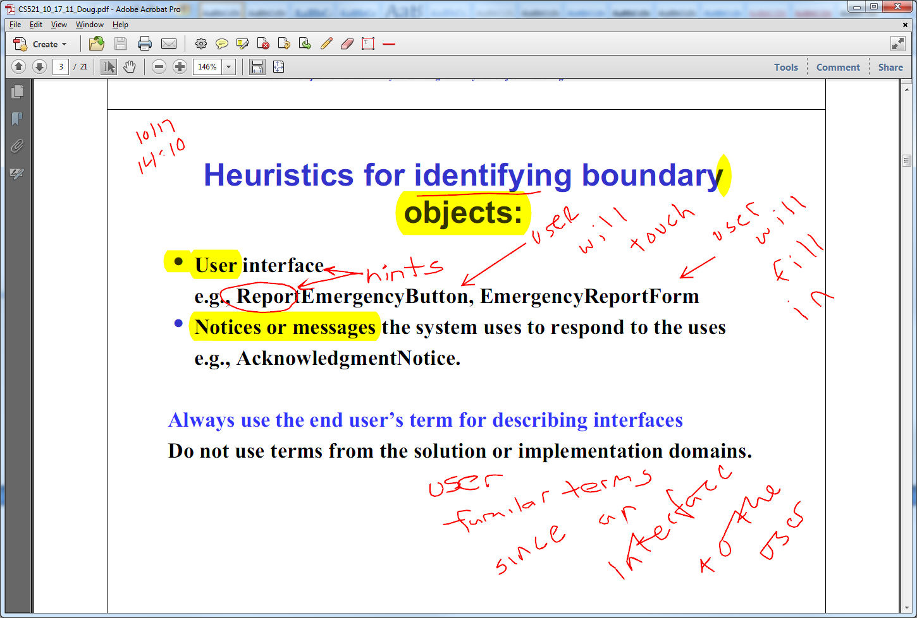
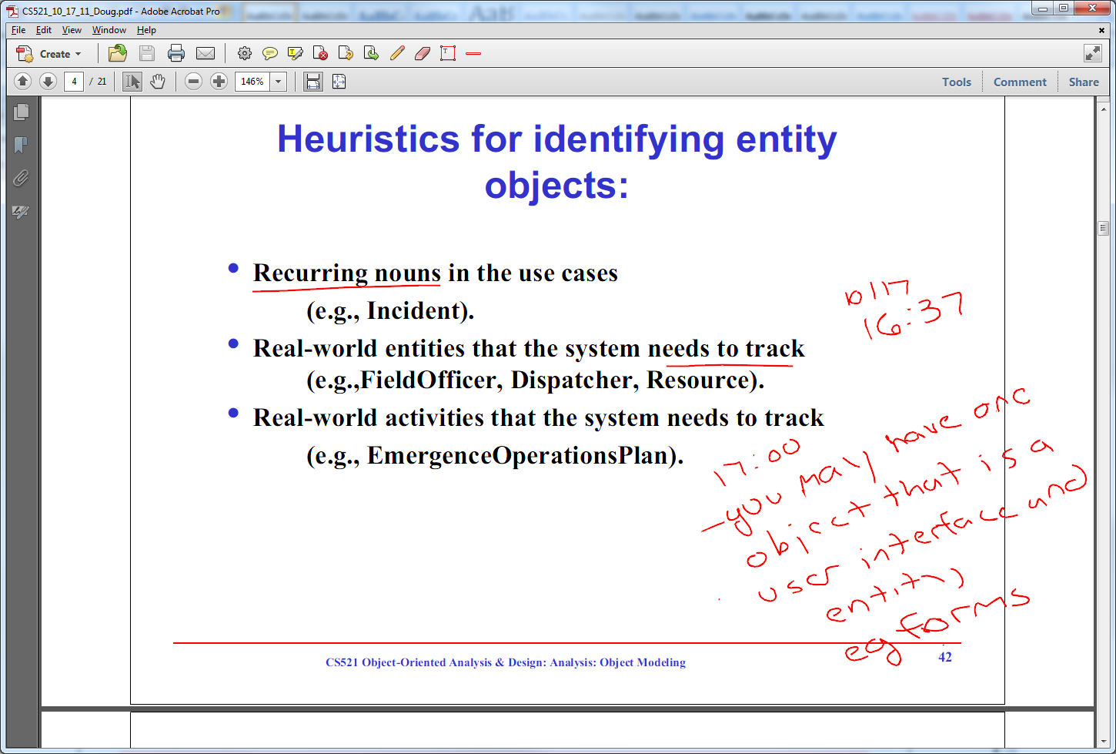
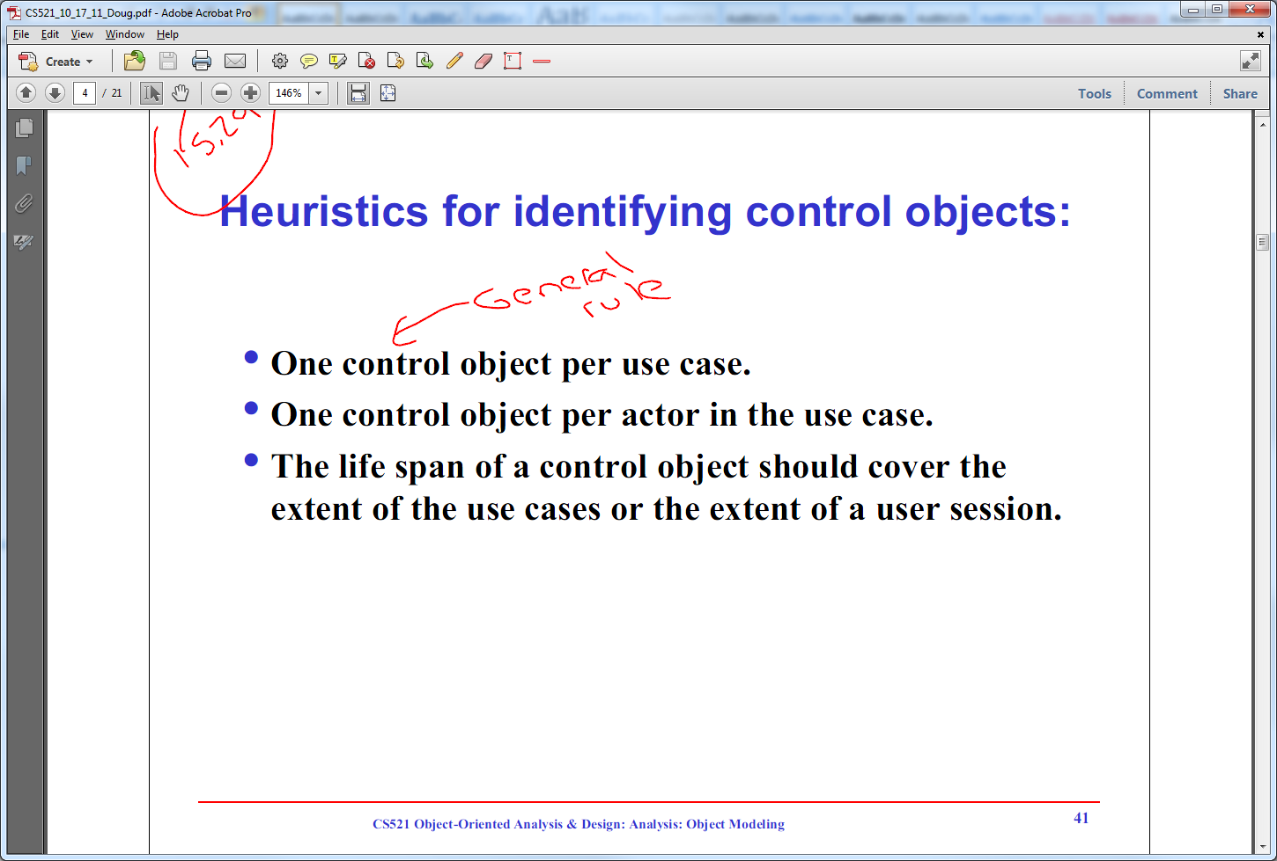

Slide 15
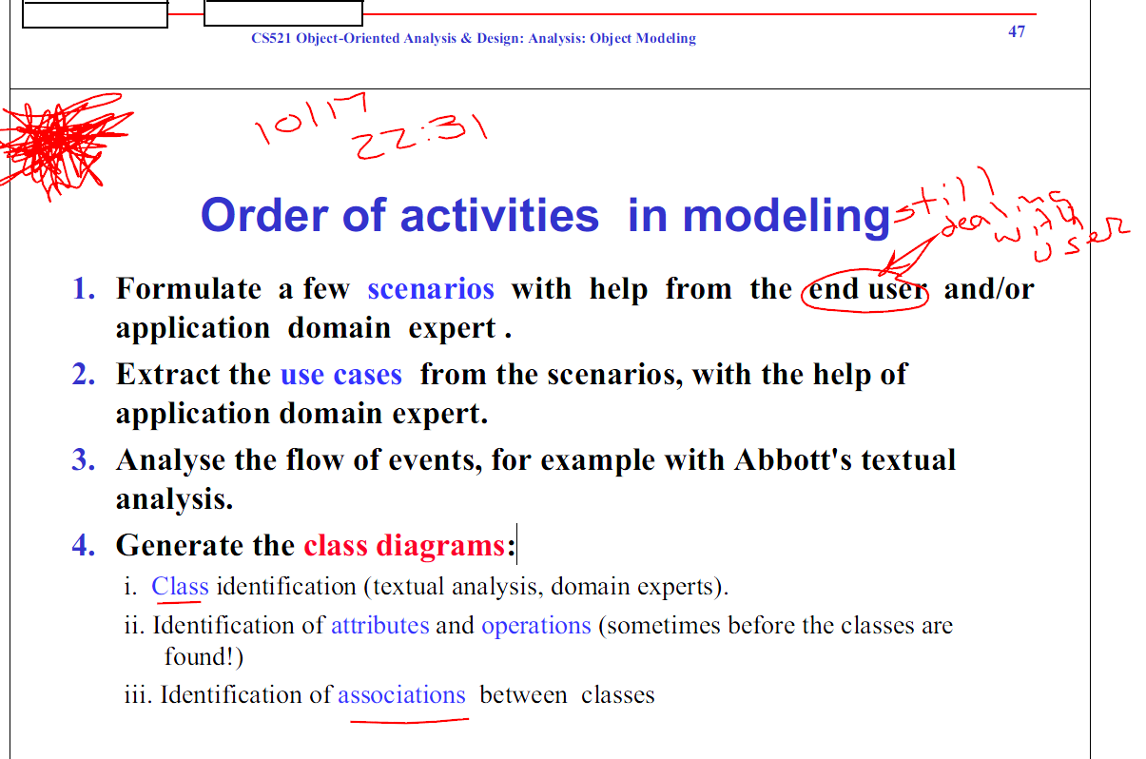

Slide 16
Inheritance is a common form of reuse and uses an “is a” relationship
We can organize classes into hierarchies of functionality
Superclass is at the top of the hierarchy and defines instant variables and methods common to all classes in the hierarchy
We derive a subclass by extending the superclass which inherits behavior and fields from the superclass
Private members of the superclass are not inherited by the subclasses
A subclass can inherit directly from only one superclass
All classes inherit from the Object class in Java
A subclass can define new methods and instance variables, some of which may override (hide) those of a superclass
Do not confuse overiding a method with overloading a method
Overiding a method is when the subclass provides a new version of that method with the same signature which hides the superclass version from the client
Overloading a method is when a class provides a version of the method, which varies in the number and/or type of parameters with a different signature. A client of the class can call any of the public versions of overloaded methods
Mutators set and accessors get
6/6/12 6:10
Helper Classes should always be declared private
Helper Classes can be inside or outside of the main class
Helper Classes should be outside and in a different file if used be multiple classes.
6/6/12 16:20 How do you organize the class structure

Slide 17
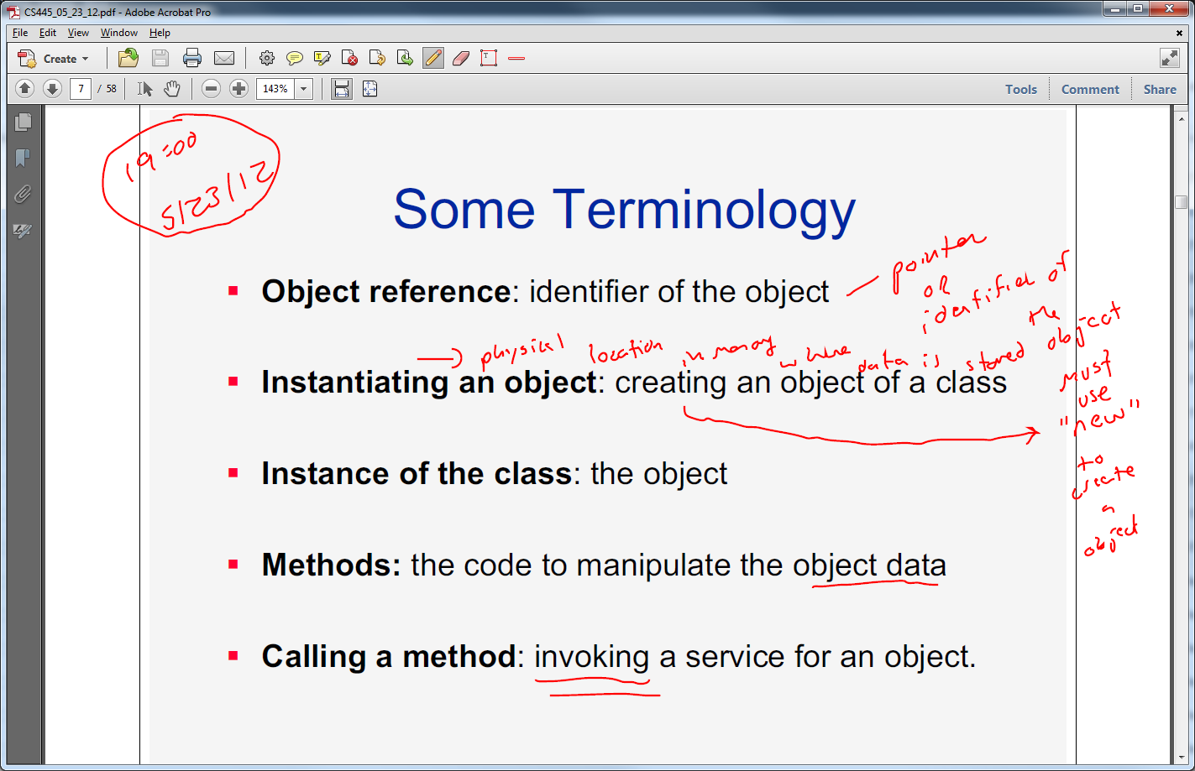
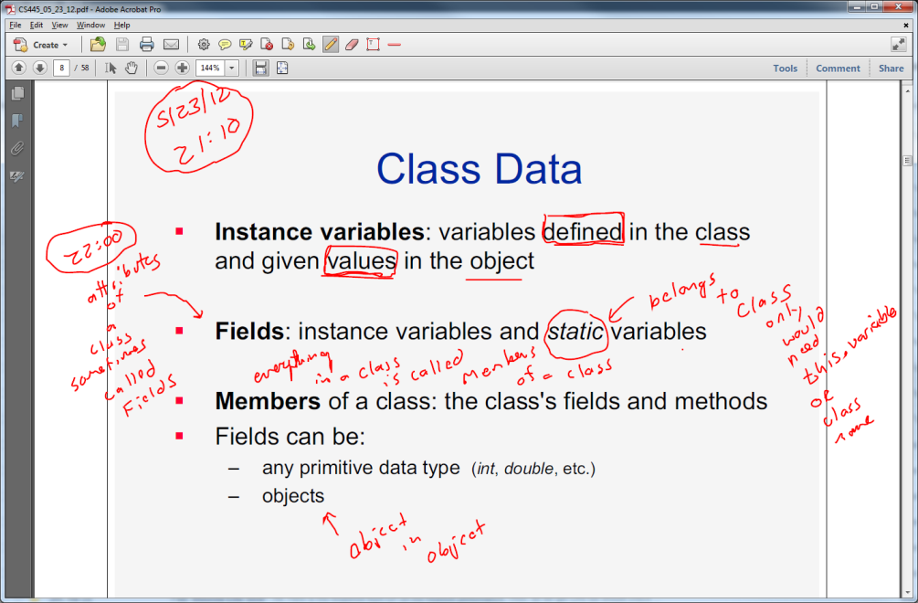
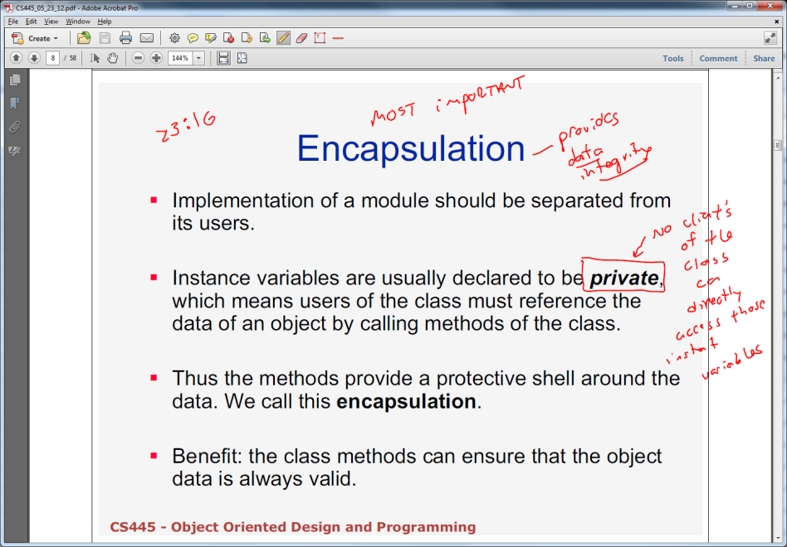
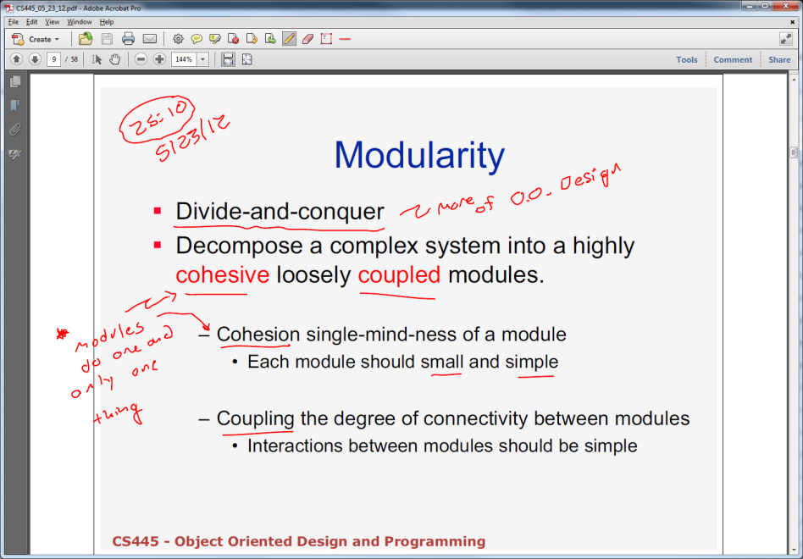

Slide 18
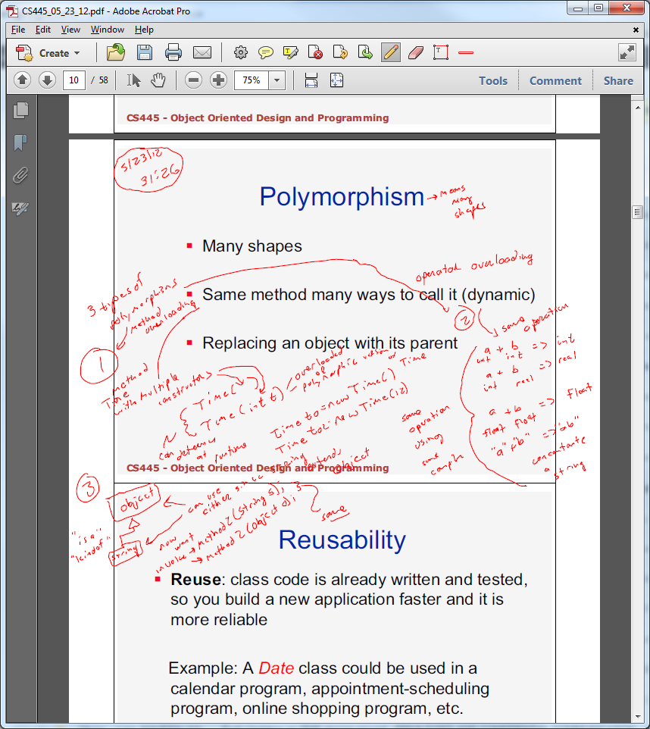
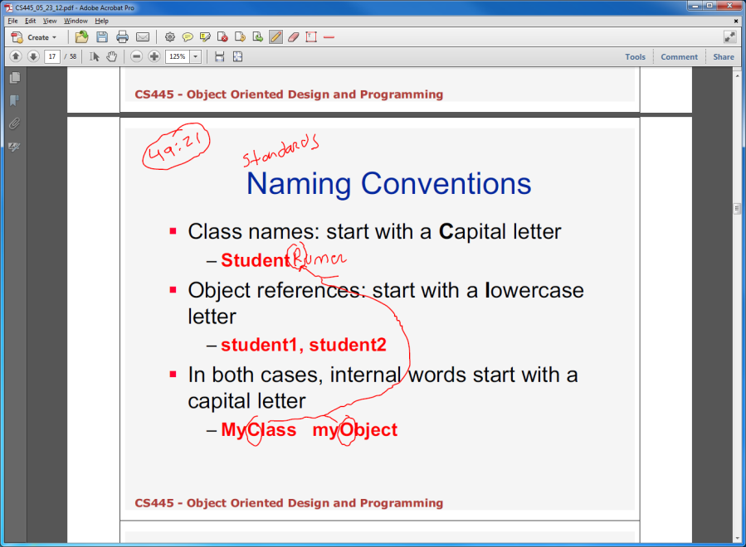
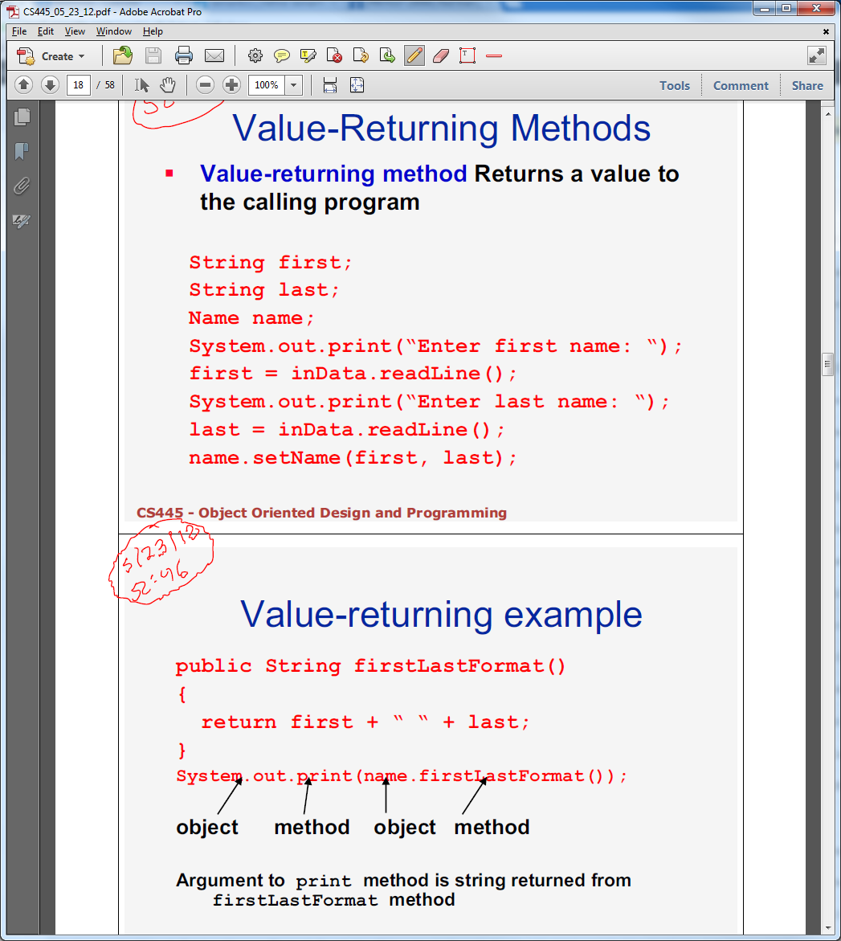
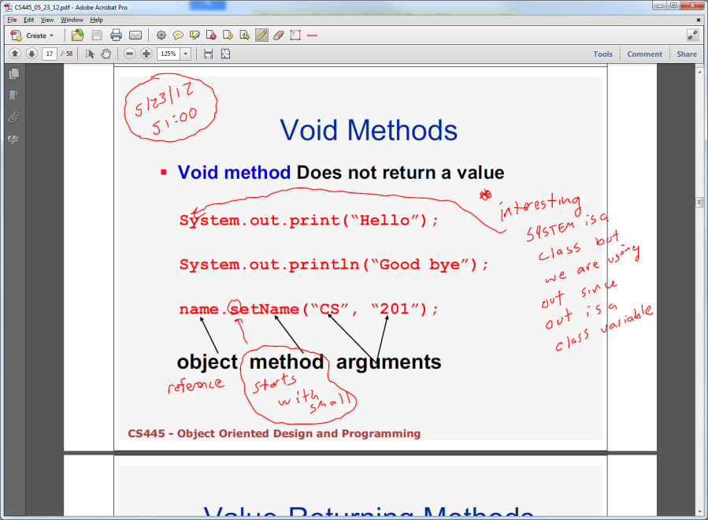

Slide 19
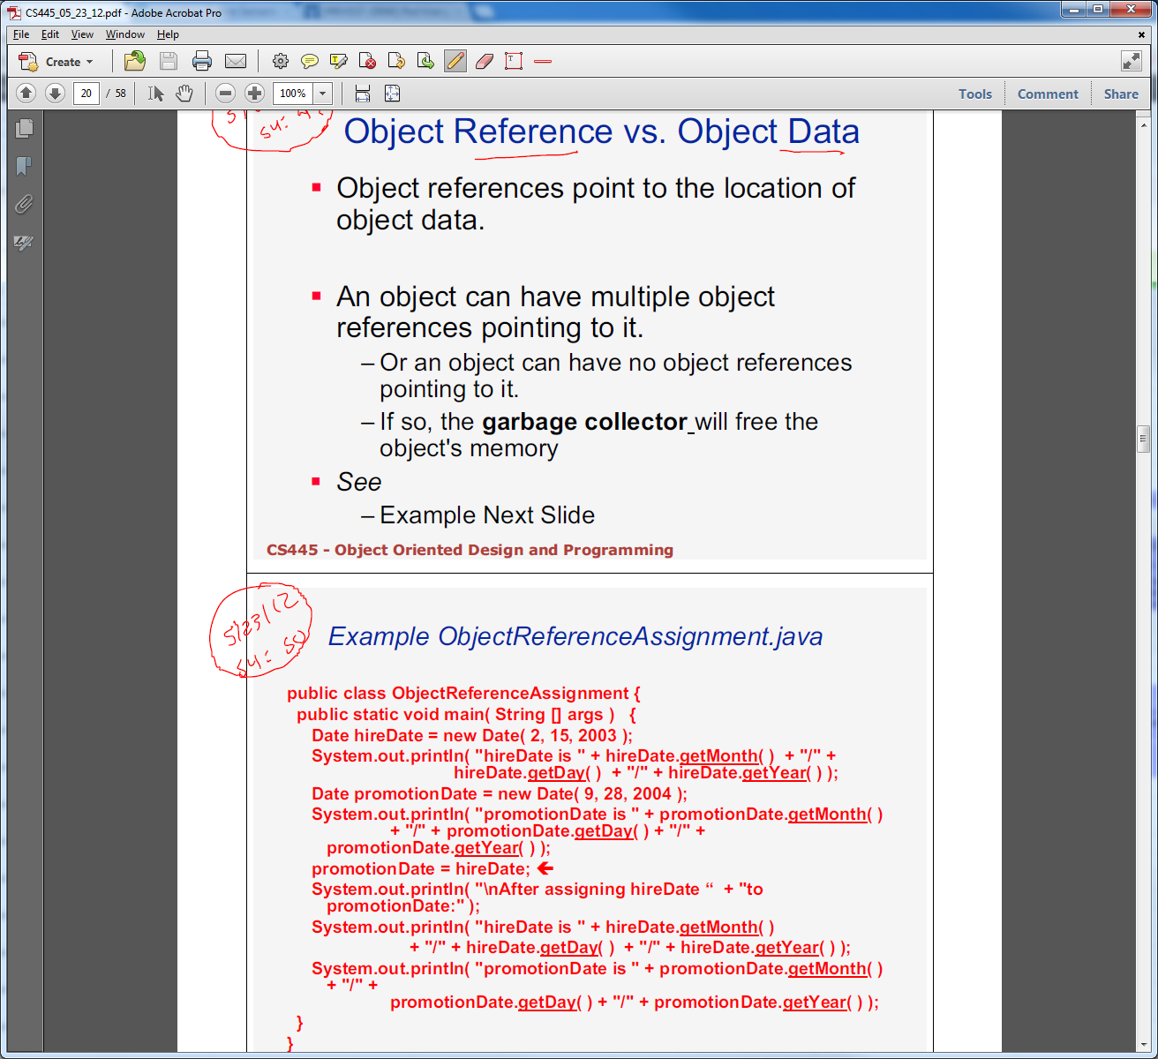
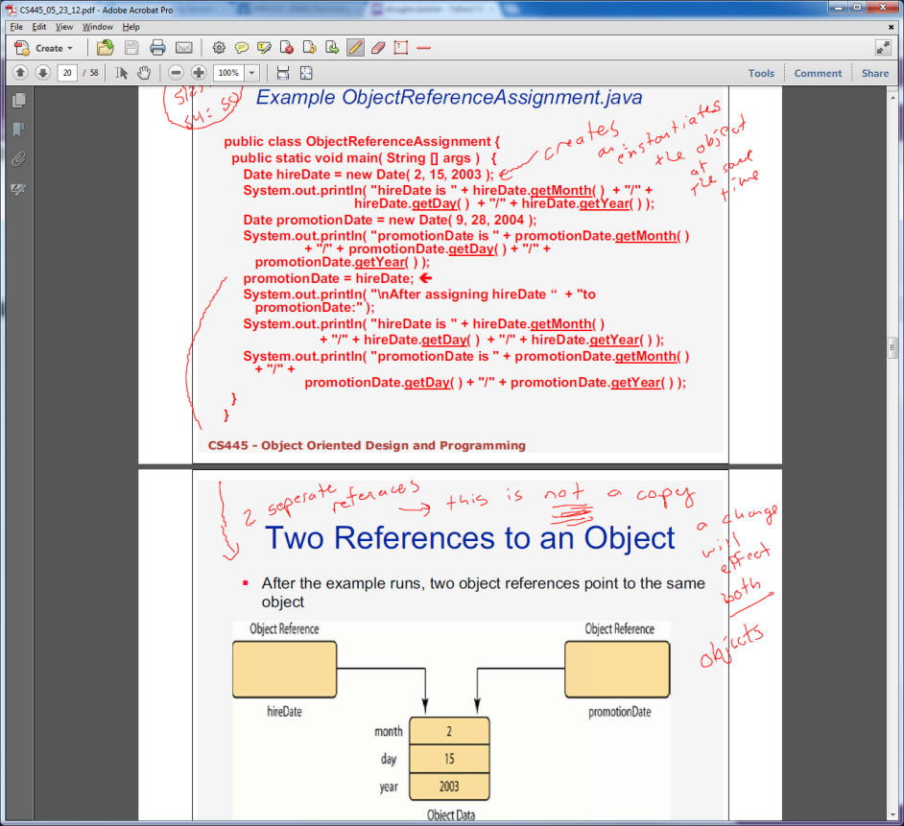
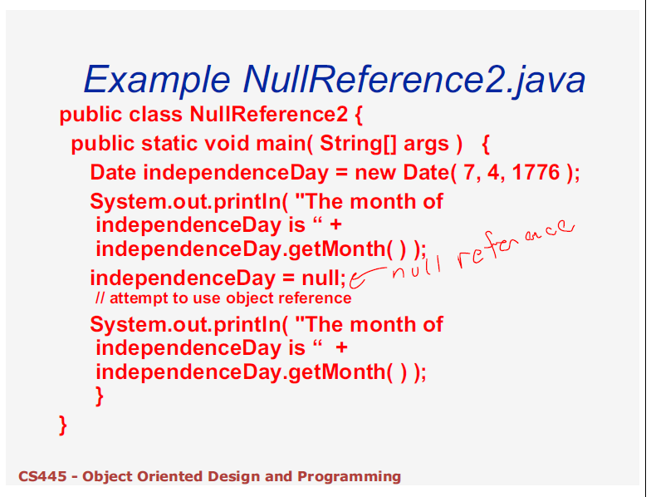

Slide 20
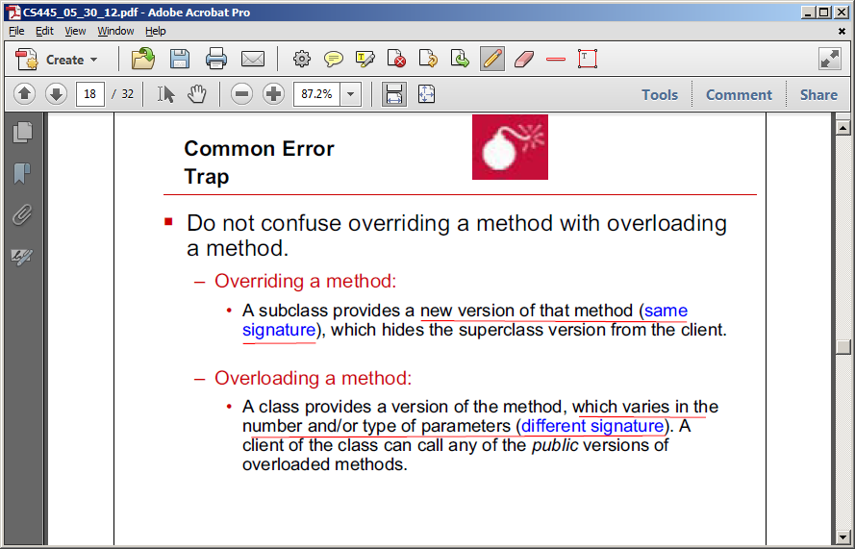
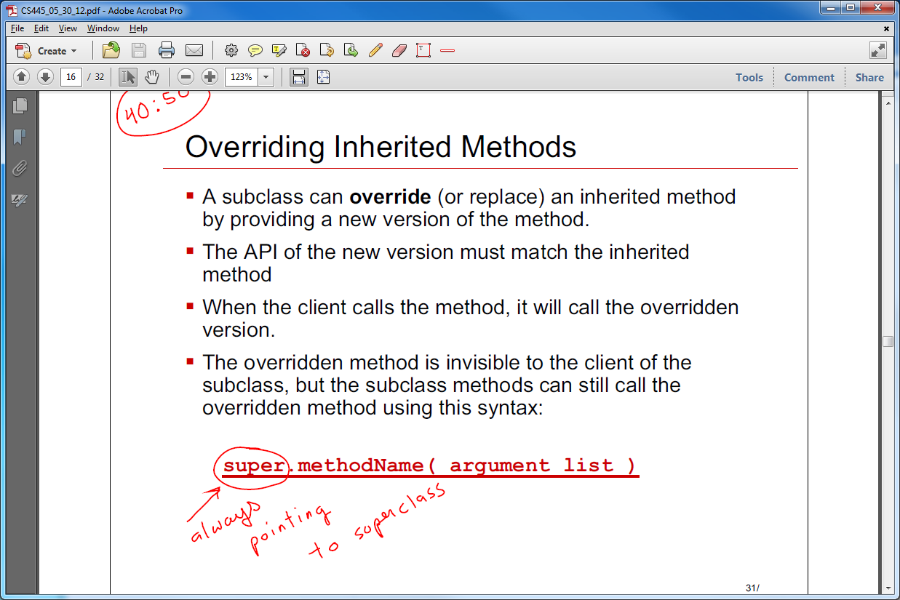
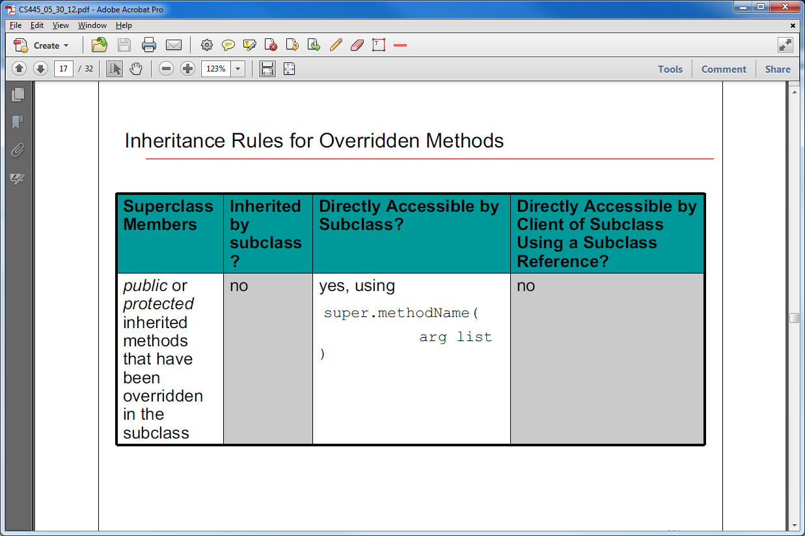
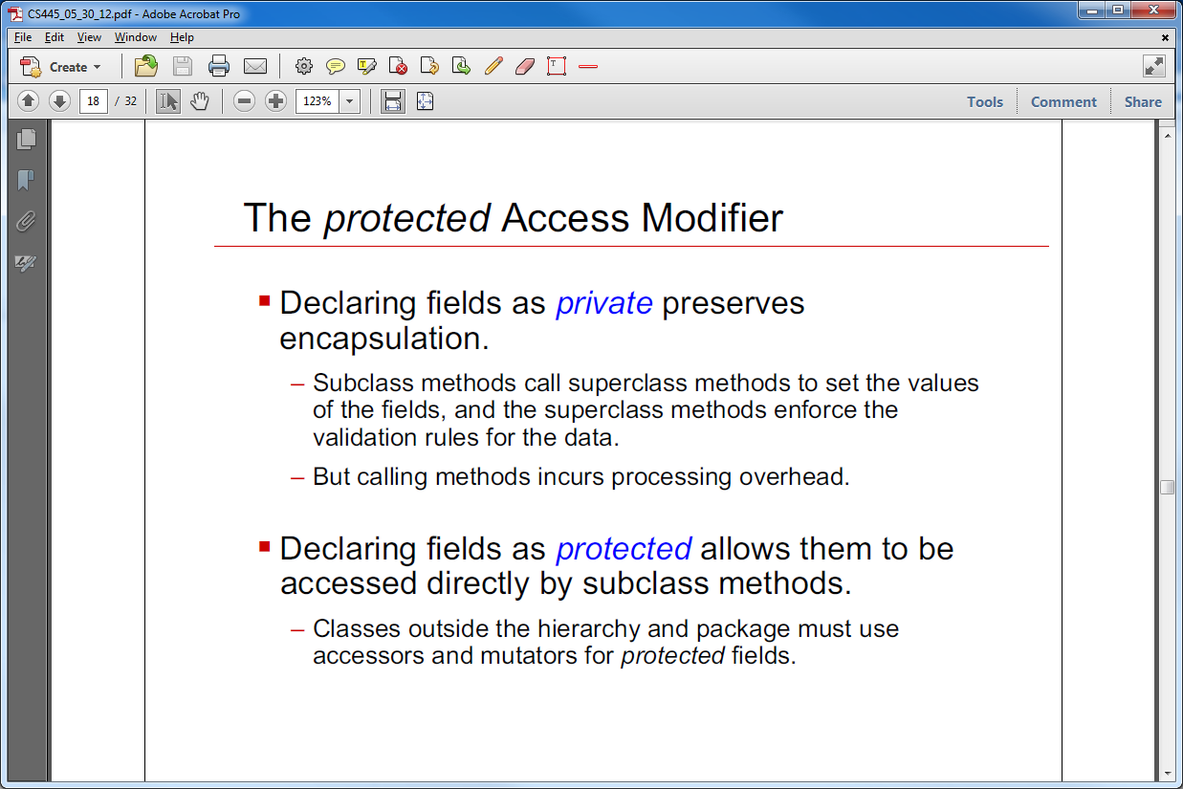

Slide 21
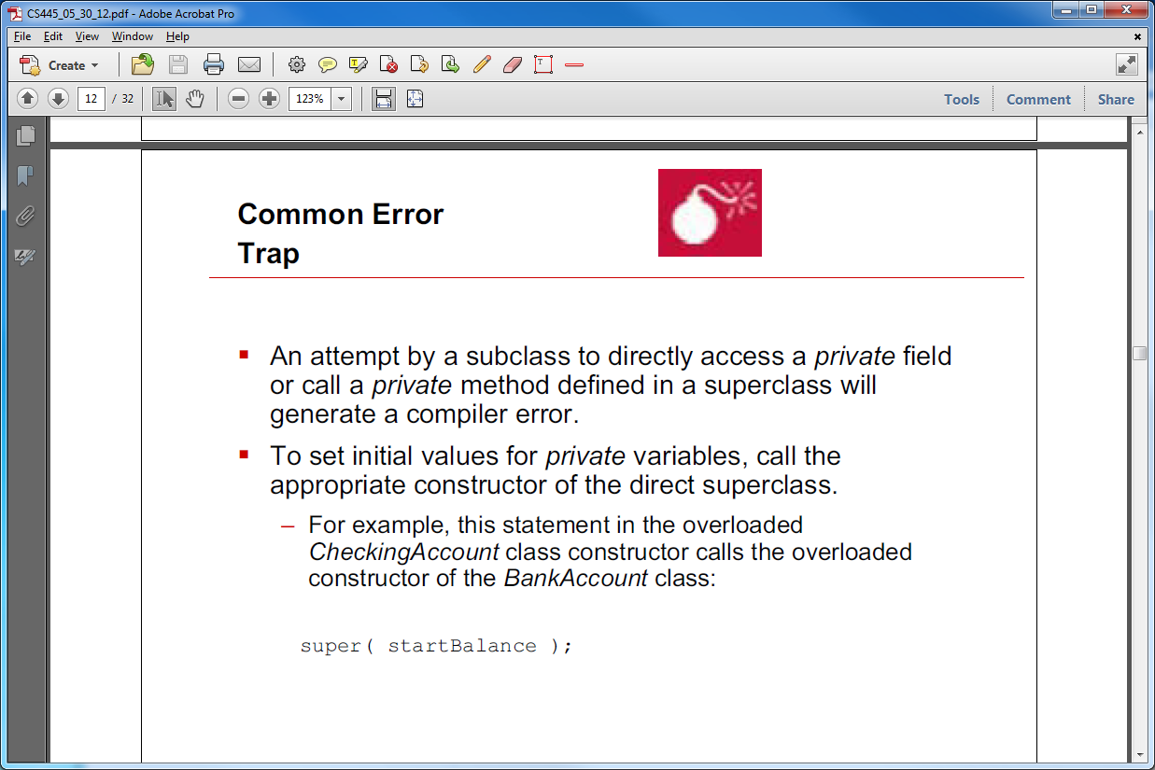
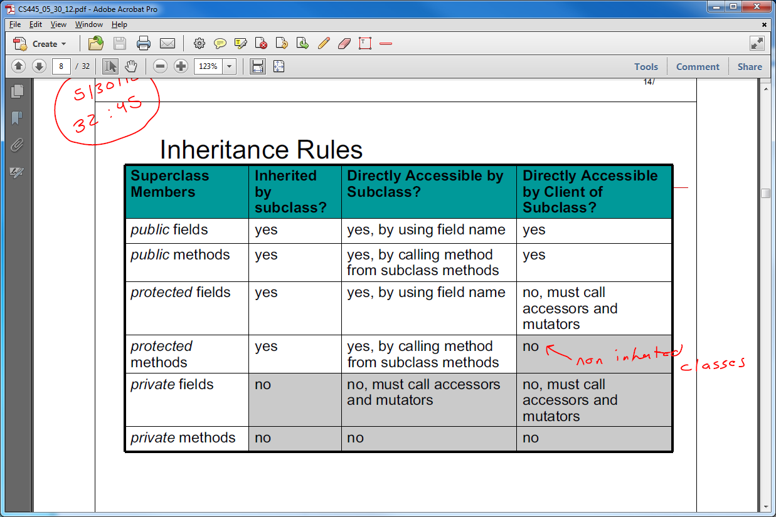
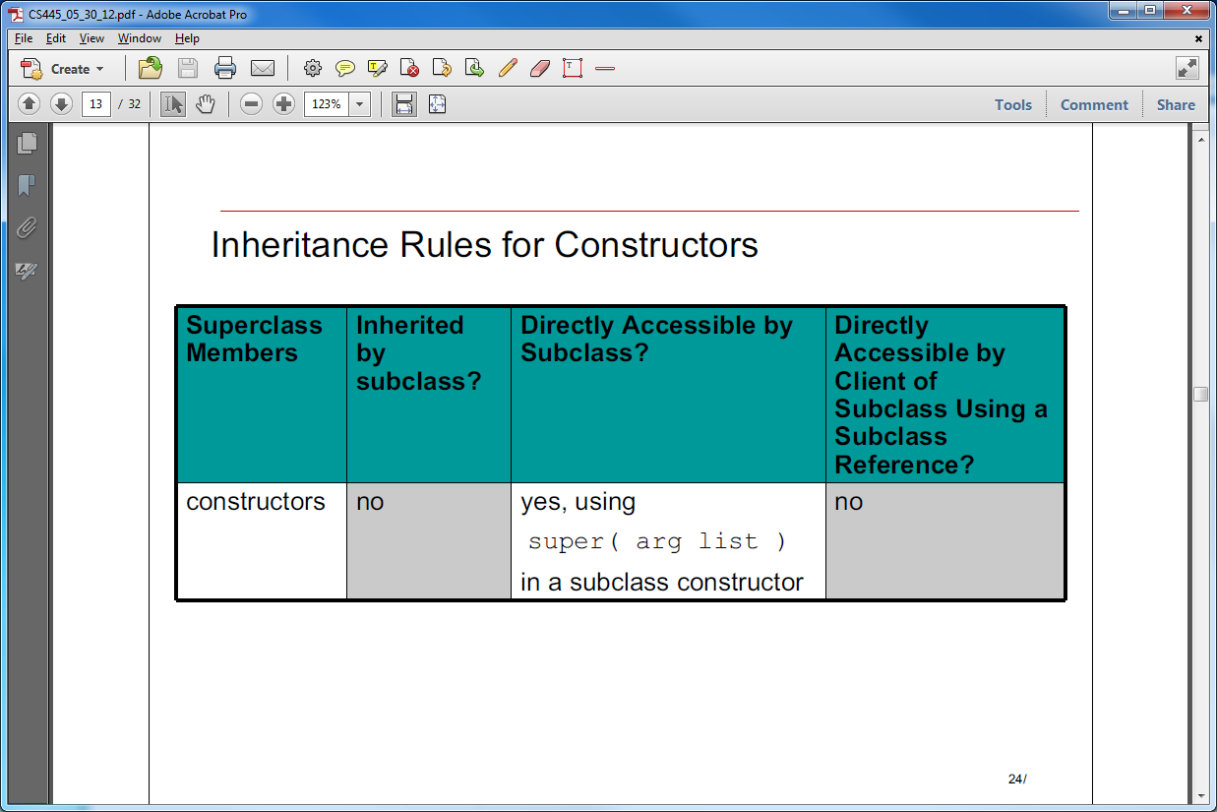

Slide 22
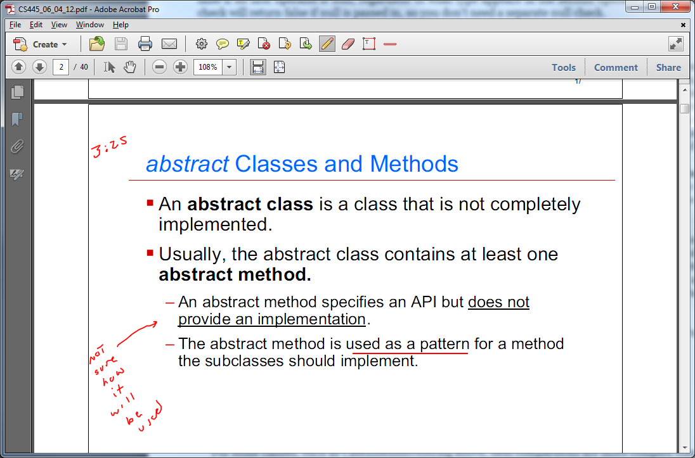
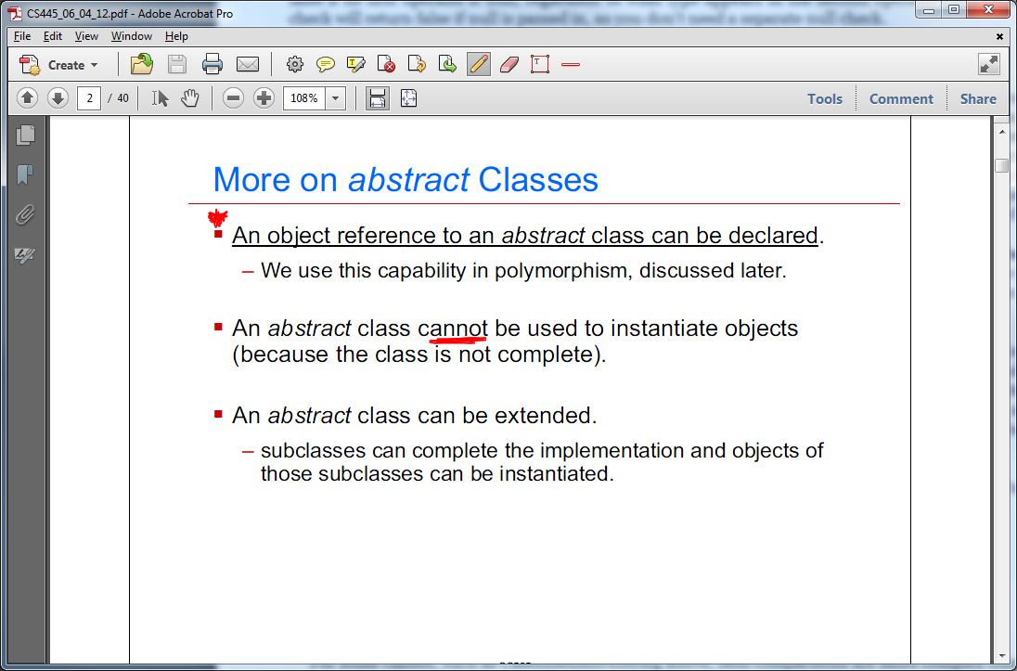
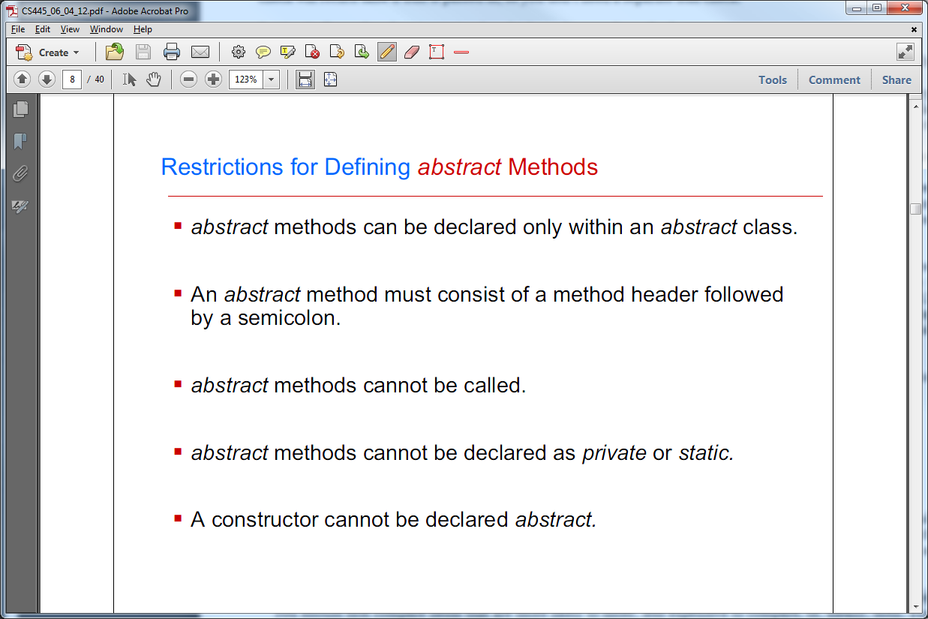
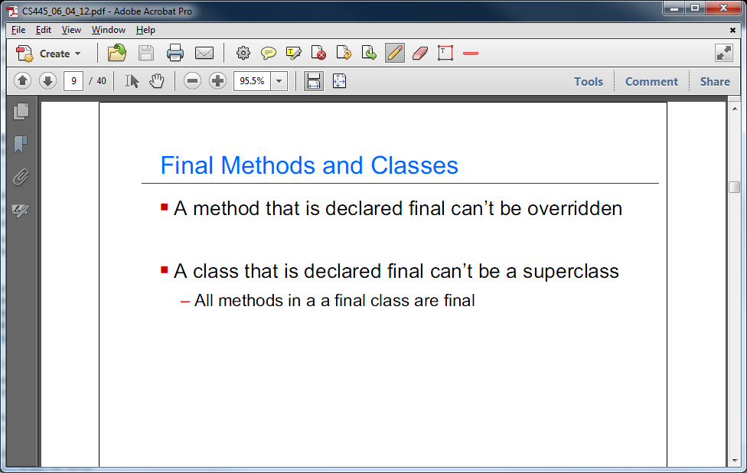

Slide 23
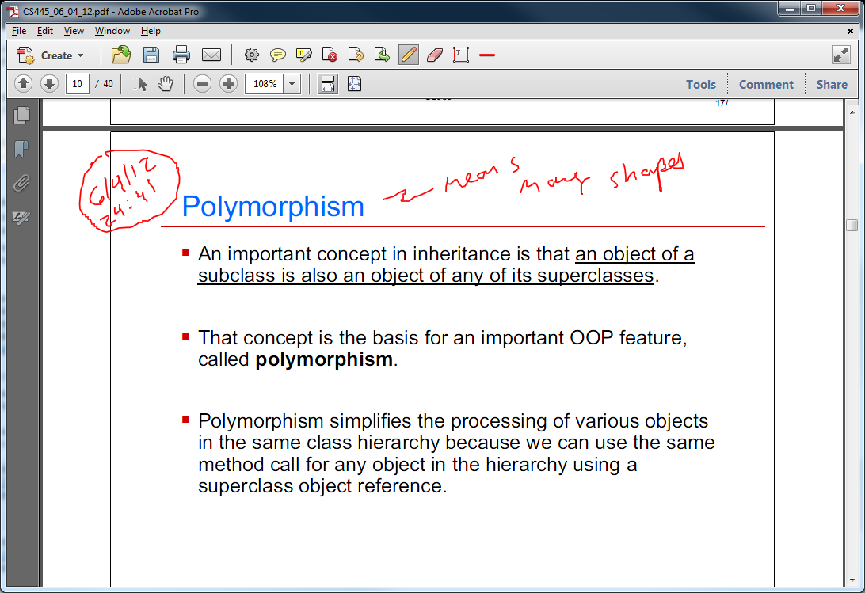
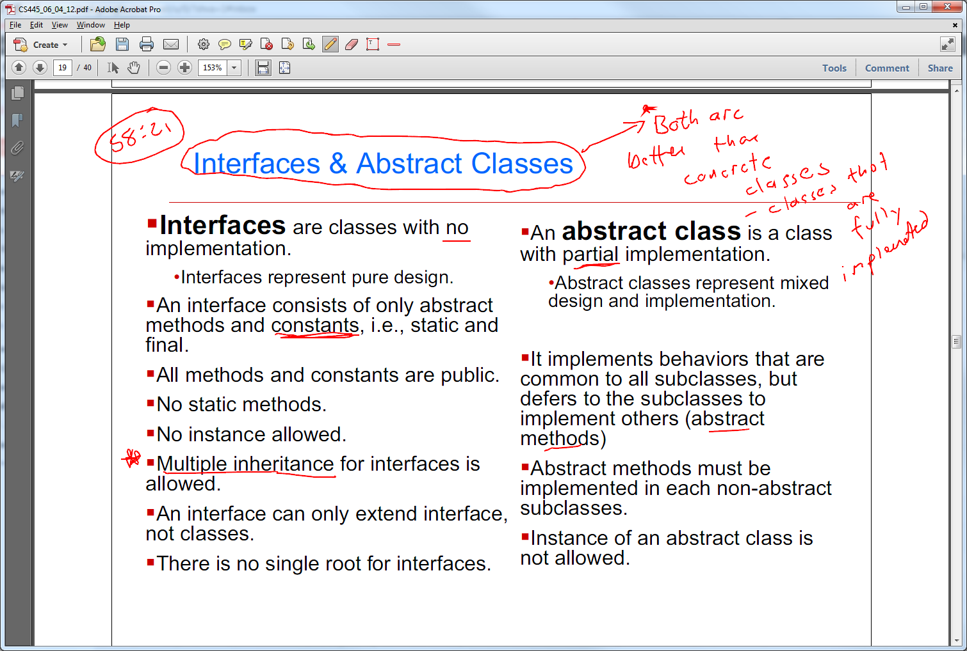

Slide 24
PURE: Correct definition of an efficiently of an algorithm: An algorithm is efficient if it has a polynomial running time
IMPLEMENTATION SPECIFIC: Deficient definition of an efficiently of an algorithm: An algorithm is efficient if, when implemented, it runs quickly on real input instances
The second definition is tied to a specific implementation of an algorithm, turning efficiently into a moving target: as processor speeds increase, more and more algorithms fall under this notation of efficiency. Our definition in terms of polynomial time is much more an absolute notation.

Slide 25
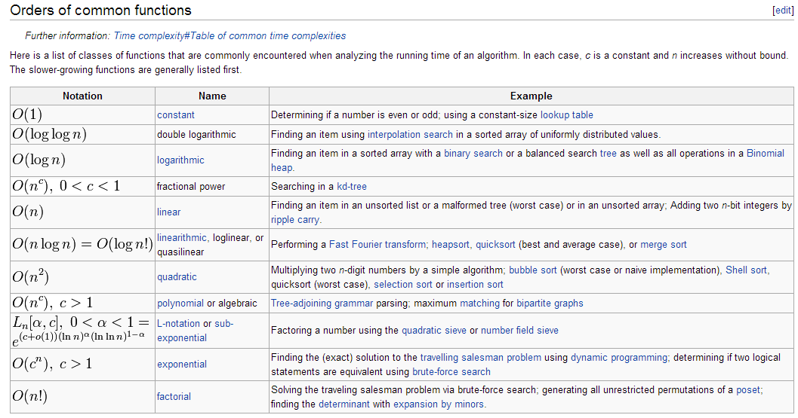

Slide 26
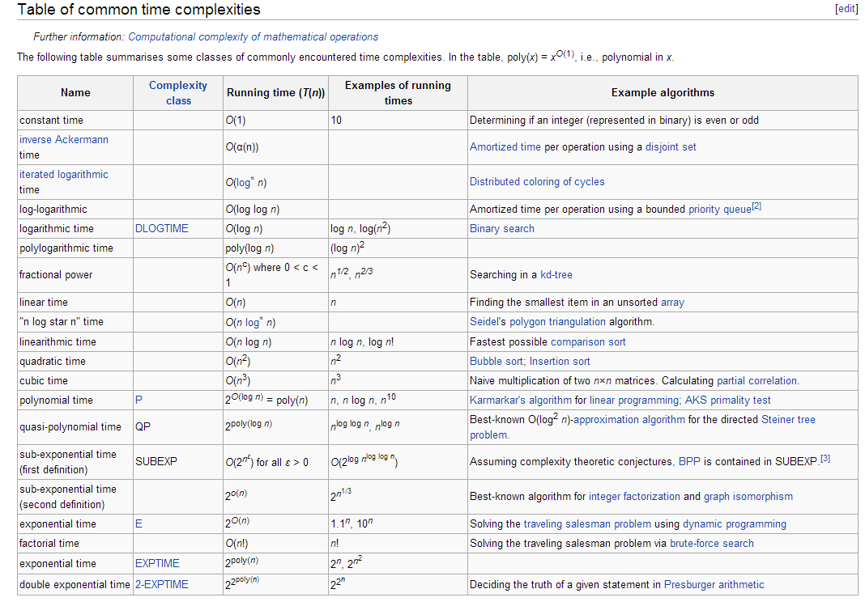

Slide 27
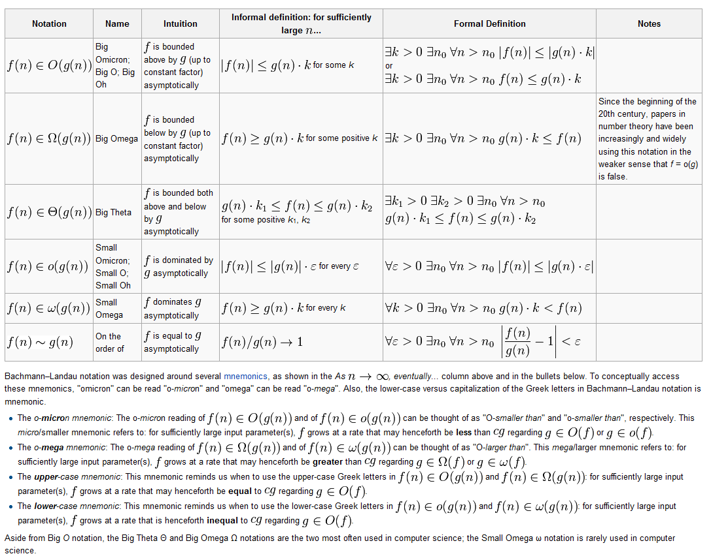

Slide 28
